Slide 1

Portfolio Resilience in Volatile Markets SUSTAINABLE VS. TRADITIONAL ENERGY SOURCES (2007-2023)
Paul Carpen

Slide 2
CRUDE OIL
CLEAN ENERGY

Slide 3


Slide 4

ADA
Did you know?
88% of the S&P 500 assets are owned by only 3 companies?
In the US, only around 10% of government bonds are owned by individuals!
Source: https://business.gmu.edu/news/2025-02/power-passive-investors-double-edged-sword

Slide 5

The Correlation Conflict

Slide 6
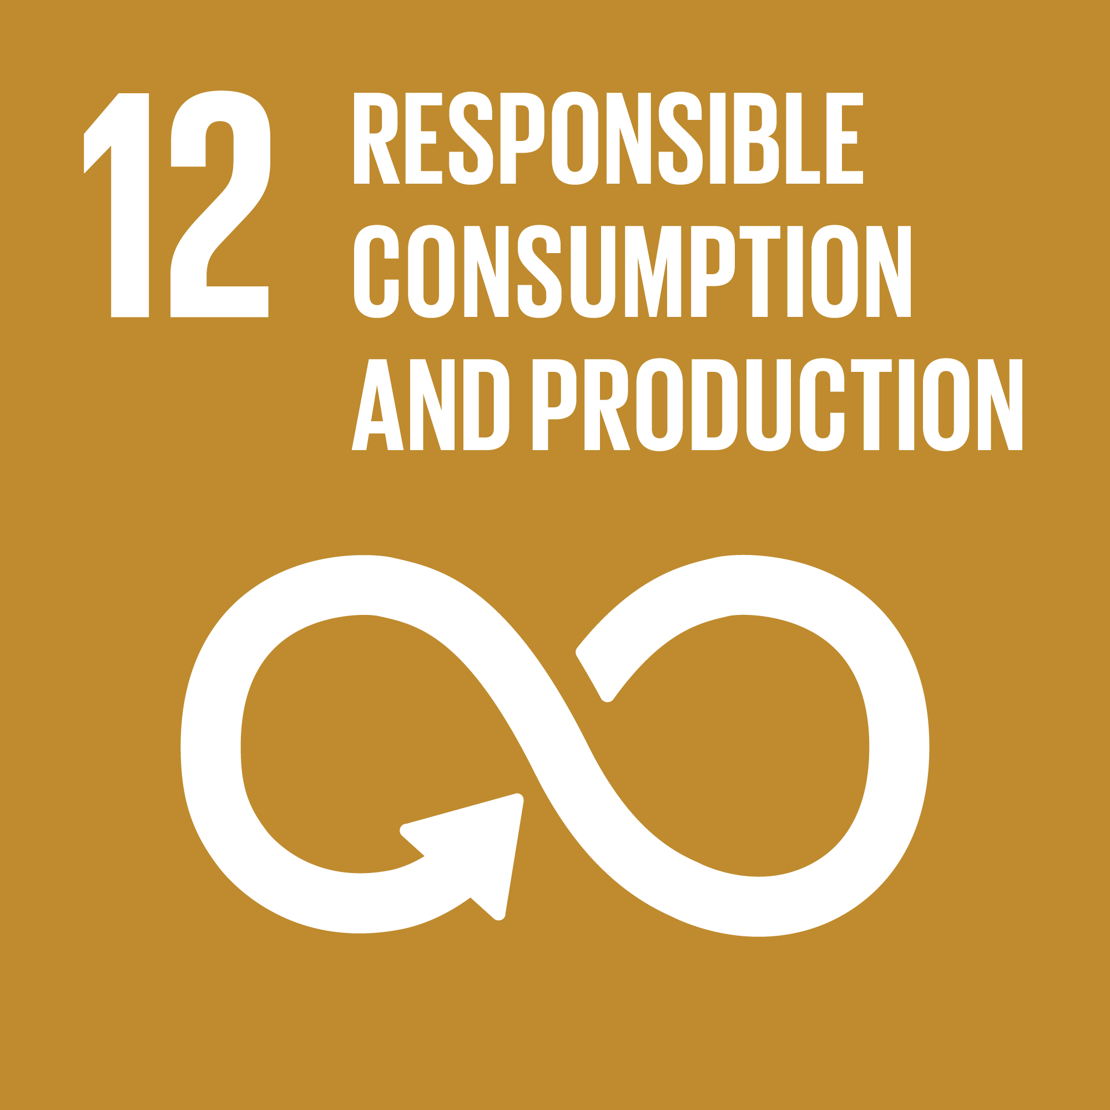

THE RESOLUTION
Having a suitable alternative for long term investments now, other than crude oil, gold and government issued bonds, this data could represent a call to action for regulatory bodies in order to limit the bond ownership of large financial institutions. This is not at all a revolutionary concept, such measures being practised in several countries since the 18th century!

Slide 7

Limitations
Limitations: Sustainable energy data from 2007-2012 has a smaller sample size than Oil.
Choice: Why 2007–2023? To capture two major macroeconomic events.

Slide 8

Financial Resilience = Sustainable Impact.
Data: www.marketwatch.com, www.oenb.at

